Slide 2
Insert your session number and session title here

Slide 6
http://bie.org/object/video/elementary_project_courtyard_redesign

Slide 7
https://www.youtube.com/watch?v=kTwcB5MyaHY

Slide 8
elocution
inflection
loudly
body language
articulation
pitch
enunciation
poise
hold head up
rhythm
stance
slowly
volume
enthusiasm
clearly
tone
eye contact
posture
gestures
look at audience
stand up straight
body movement
expression
projection
presence
fluid expression
intonation
vocal modulation

Slide 9
Necessary
Sufficient
Doable
Understandable

Slide 10
Two distinct parts
Building a speech
Performing a speech

Slide 11
Building
Audience
Content
Organization
Visual aids
Appearance

Slide 12
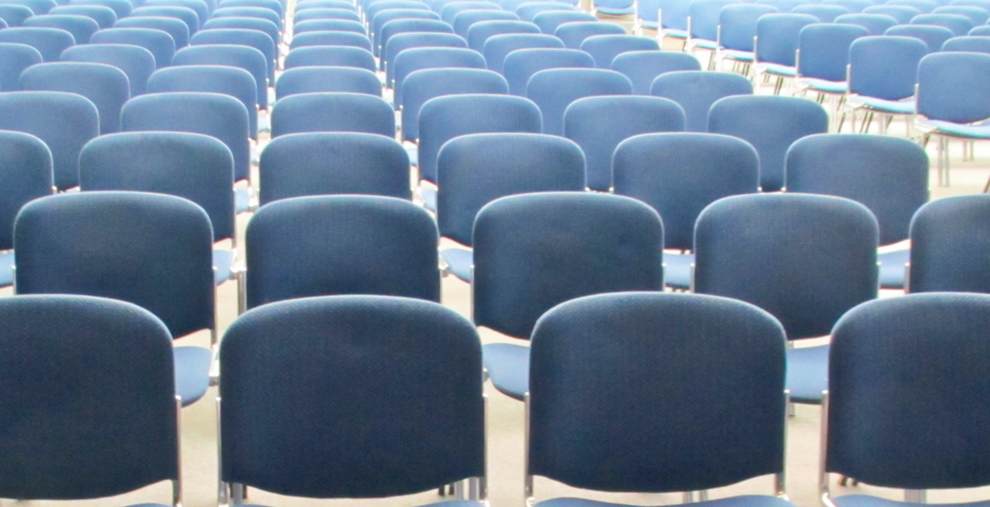
Audience
Who?
What?

Slide 13
Content
Interesting information
Important information

Slide 14
Content
Connectors
Clarifiers
No verbal viruses

Slide 15
Organization
Basic speech plan

Slide 16
Organization
Grabber Opening
Signposts
Powerful closing

Slide 17
Visual Aids
Relevant
Accessible
Important
Designed, not decorated

Slide 18
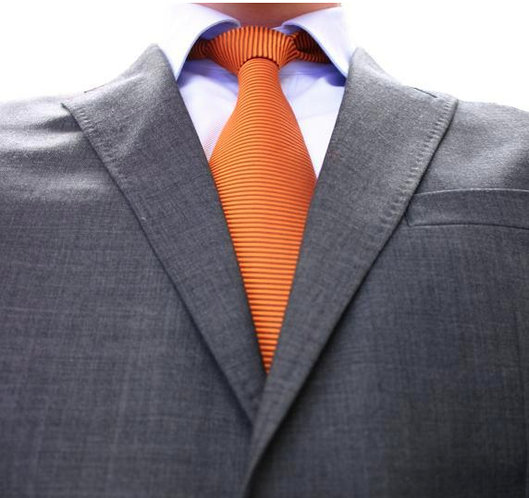
Appearance
Convey the
appropriate image

Slide 19
Building
Audience
Content
Organization
Visual aids
Appearance

Slide 20
Performing
Poise
Voice
Life
Eye contact
Gestures
Speed

Slide 21
Poise
Calm & confident
No shuffling, rocking, fidgeting
That one thing you do

Slide 22
Voice
Every word heard

Slide 23
Life
Feeling
Emotion
Passion

Slide 24
Eye Contact

Slide 25
Hands
Gestures
Face
Body

Slide 26
Speed
Too fast?
Fast & slow
Pause

Slide 27
Performing
Poise
Voice
Life
Eye contact
Gestures
Speed

Slide 28
BUILDING
PERFORMING
Poise
Voice
Life
Eye Contact
Gestures
Speed
Audience
Content
Organization
Visual Aids
Appearance

Slide 29
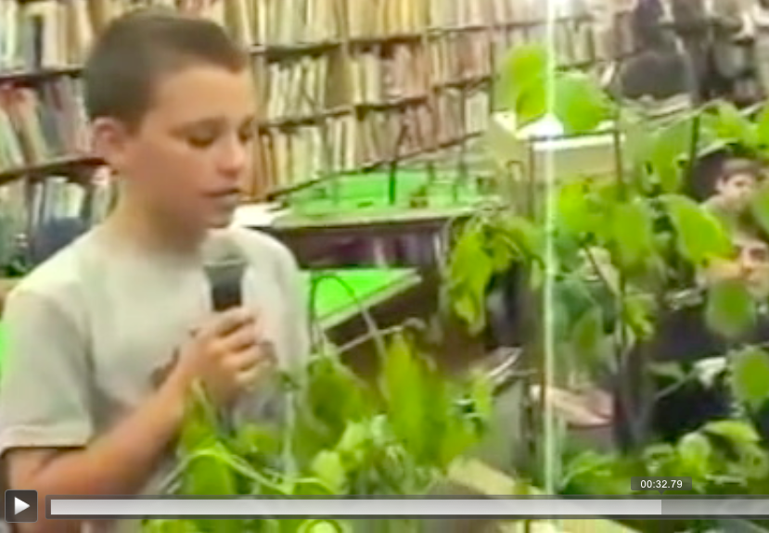

Slide 31
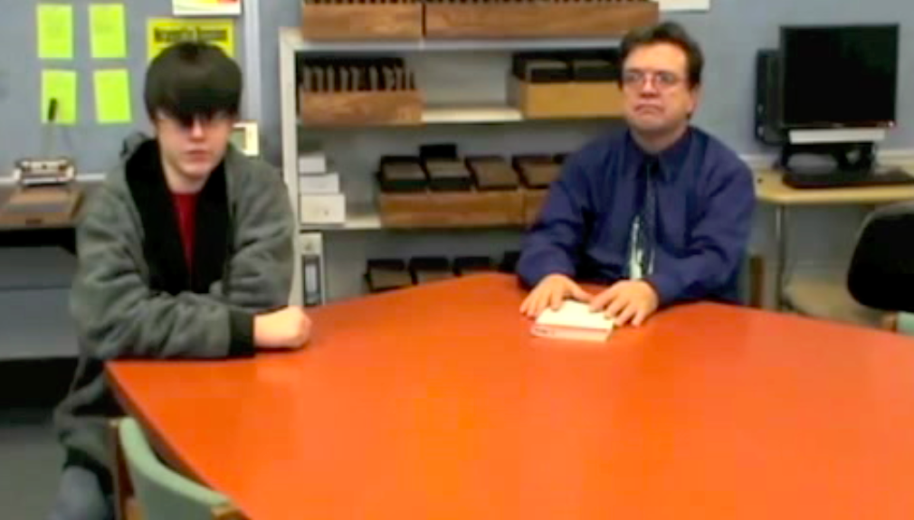

Slide 32
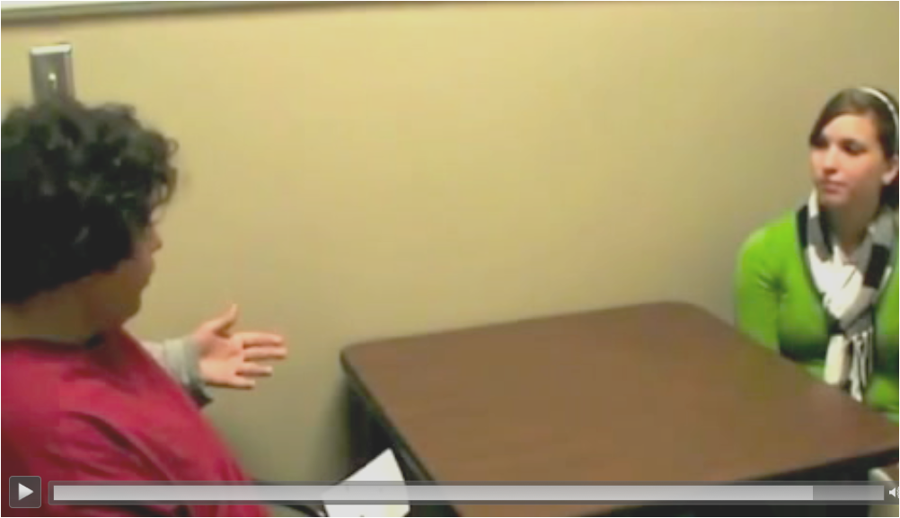

Slide 33
4th graders book reports

Slide 34
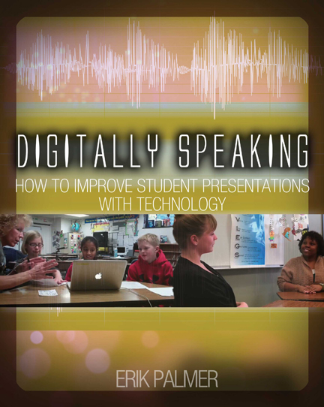
Practicing
Speaking

Slide 35
vocaroo.com

Slide 40
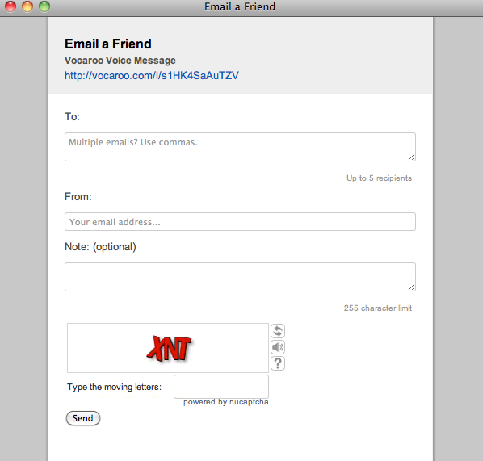

Slide 41
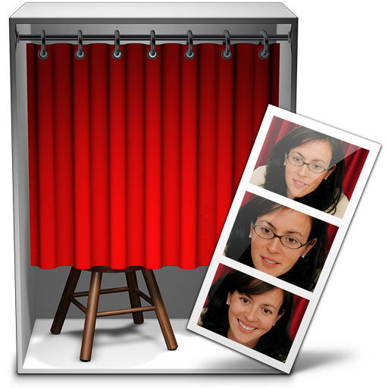

Slide 42
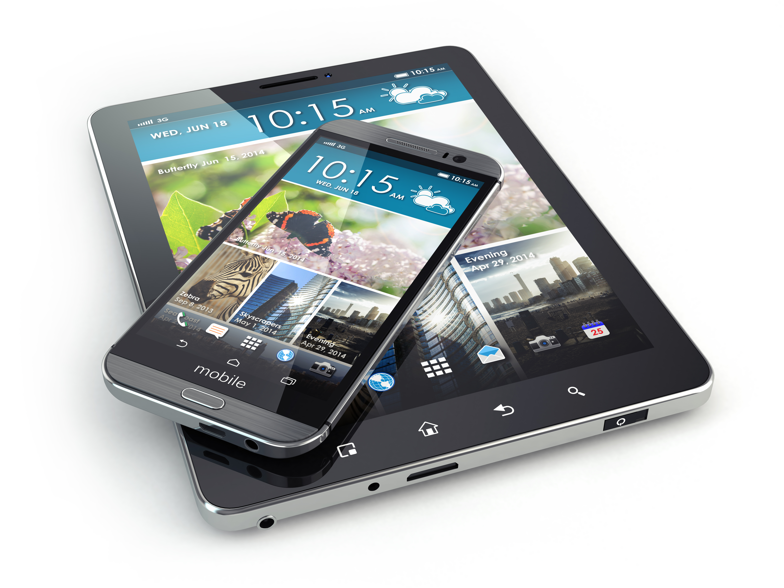

Slide 43
Continuing
discussions

Slide 44
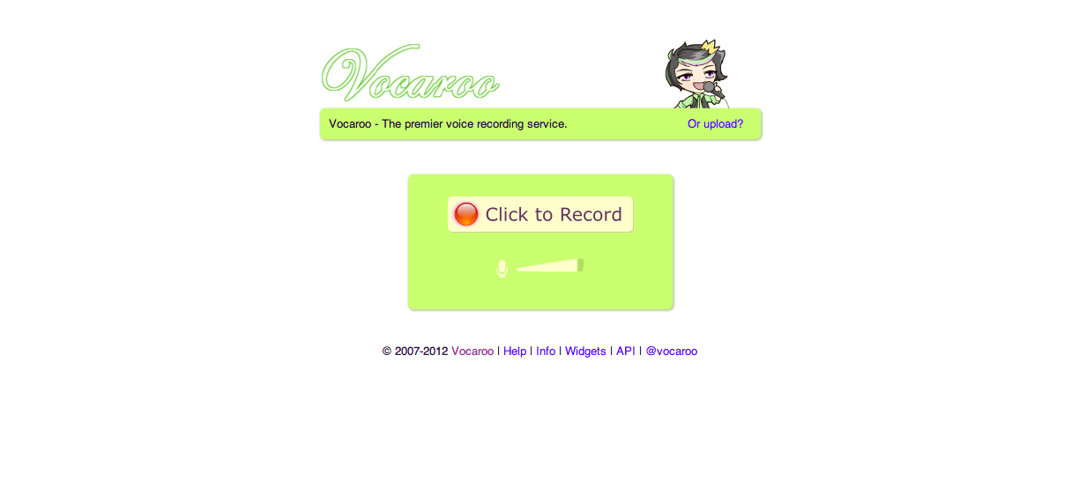

Slide 45
Google Voice
www.google.com/voice

Slide 46
vocaroo.com
email: erik_palmer@comcast.net
Googlevoice: 720.383.7451

Slide 47
flipgrid.com
flipgrid.com/#41cde9ae
Lock

Slide 48
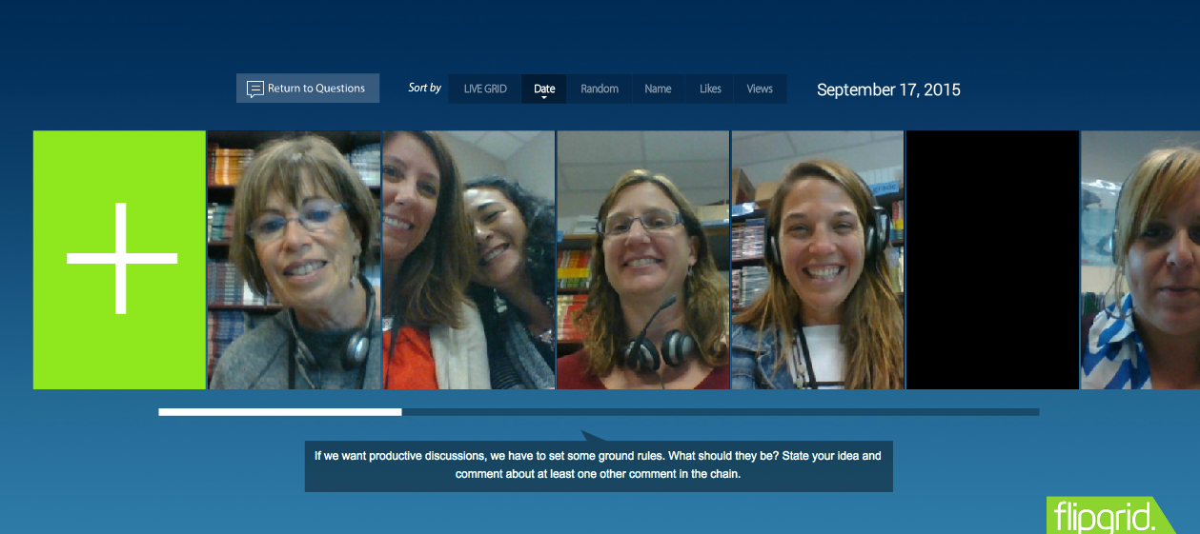
flipgrid.com
flipgrid.com/#41cde9ae
Lock

Slide 49
VoiceThread.com
https://voicethread.com/share/7979115/

Slide 50
Activities to update
Chapter summaries
Explanations
Announcements
Discussion starter

Slide 51
Publishing
Speaking

Slide 53
George Lucas

Slide 54
Understanding Sound

Slide 57
Lesson Idea

Slide 58
Frozen
Snail
Toy Story
Pirates of the Caribbean

Slide 59
Understanding Images

Slide 60
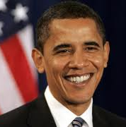
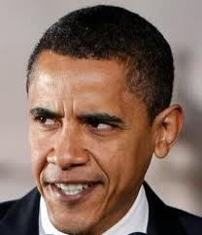

Slide 61
Lesson Idea

Slide 62
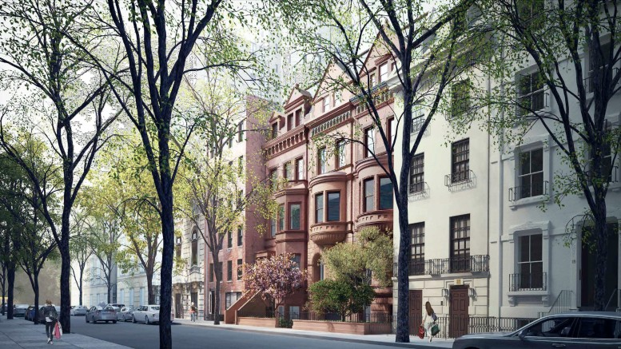
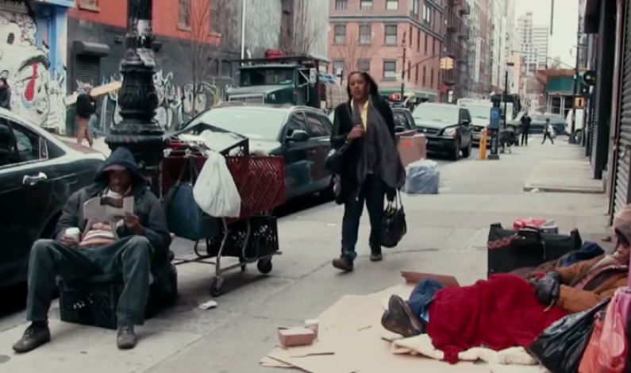
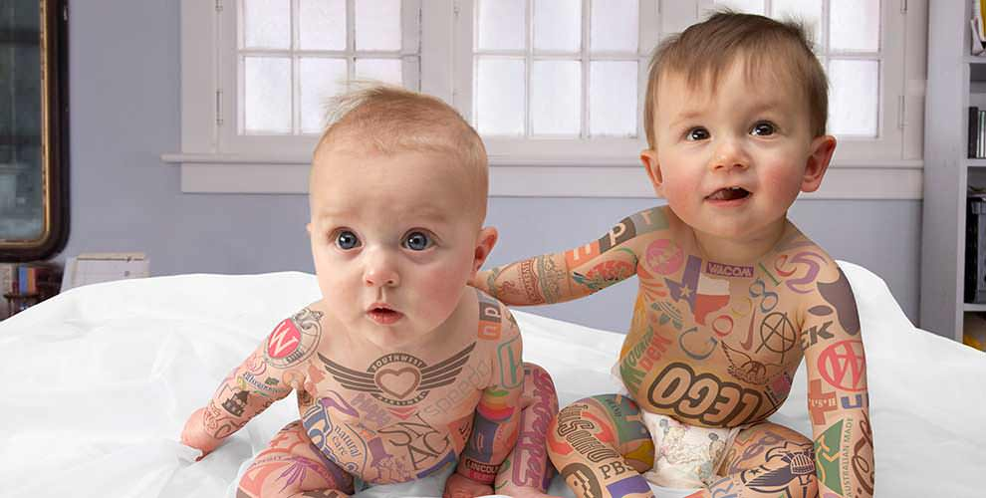

Slide 64
Reading Video

Slide 65
A Pep Talk from Kid President

Slide 66
Lesson Idea

Slide 67
Old video about light

Slide 68
New video about light

Slide 69
Building
Audience
Content
Organization
Visual aids
Appearance

Slide 70
Appearance
Convey the
appropriate image

Slide 72
Life
Feeling
Emotion
Passion

Slide 73
Camera Contact

Slide 74
Glogster
http://edu.glogster.com

Slide 75
Pretzel
http://erikpalmer.edu.glogster.com/pretzel/

Slide 76
littlebirdtales.com

Slide 77
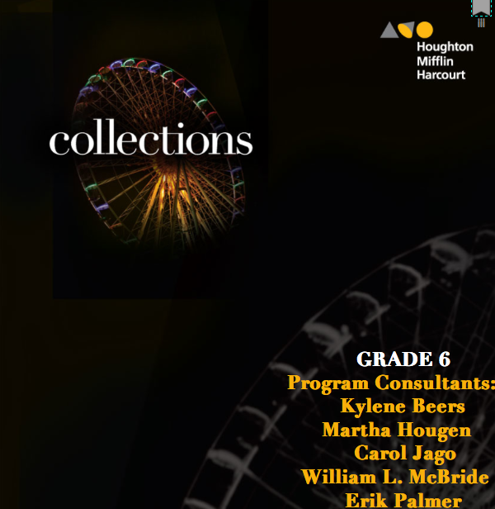
www.pvlegs.com
erik_palmer@comcast.net

